Slide 1

Stock Prediction Analysis
Based on Seasonal Financial Report
Ruocheng Jiang

Slide 2


Data Source
https://finviz.com/
https://finance.yahoo.com/

Slide 3
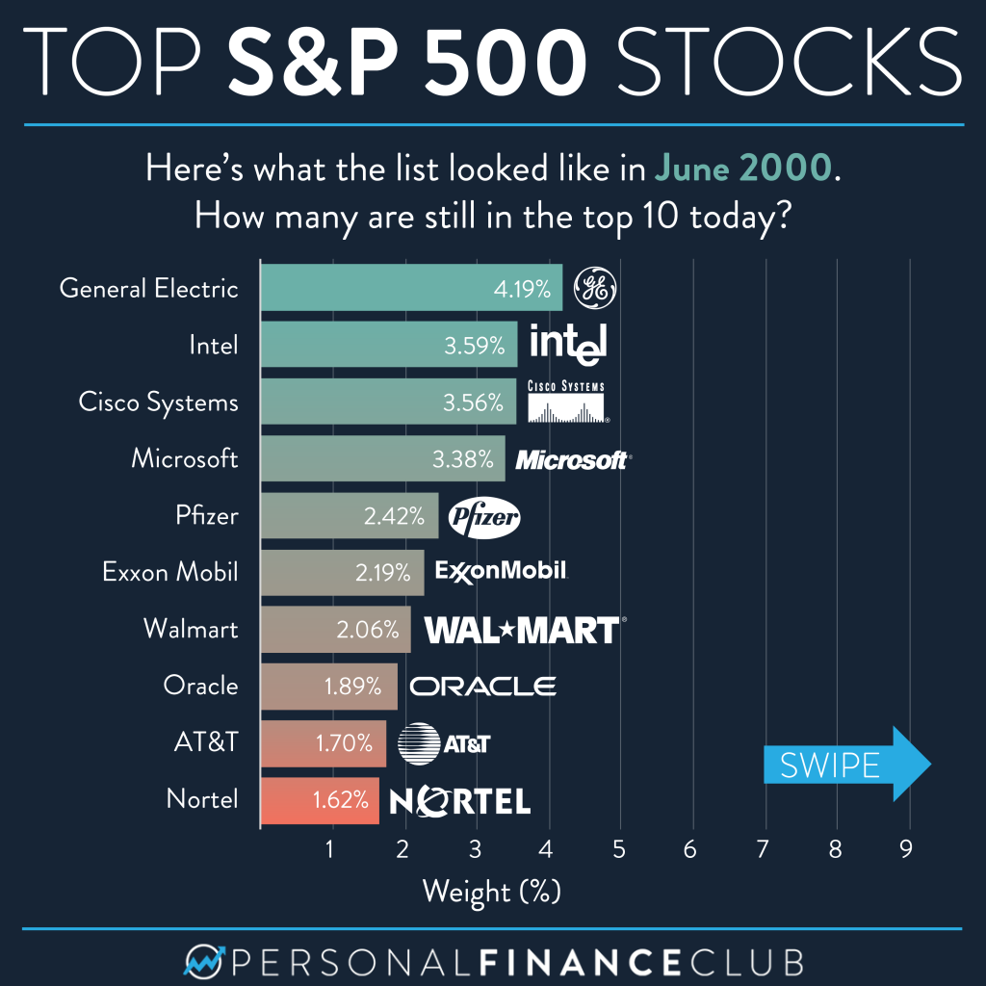





Slide 4
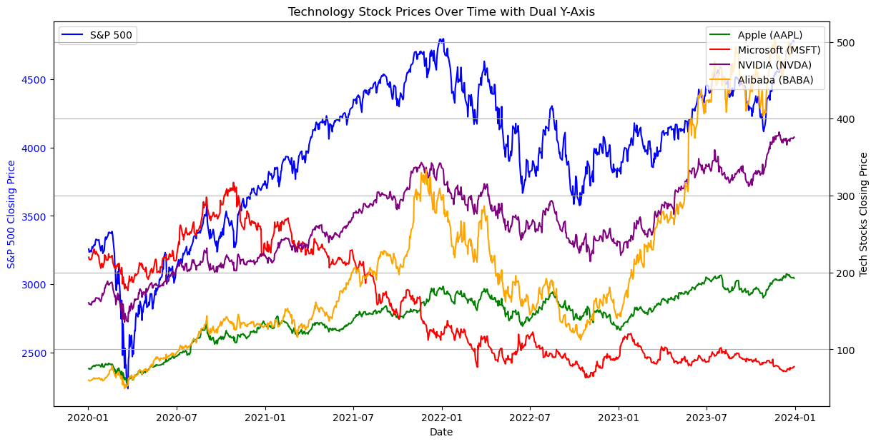

Slide 5
Seasonal Changes?
Changepoint Detection Analysis …

Slide 6
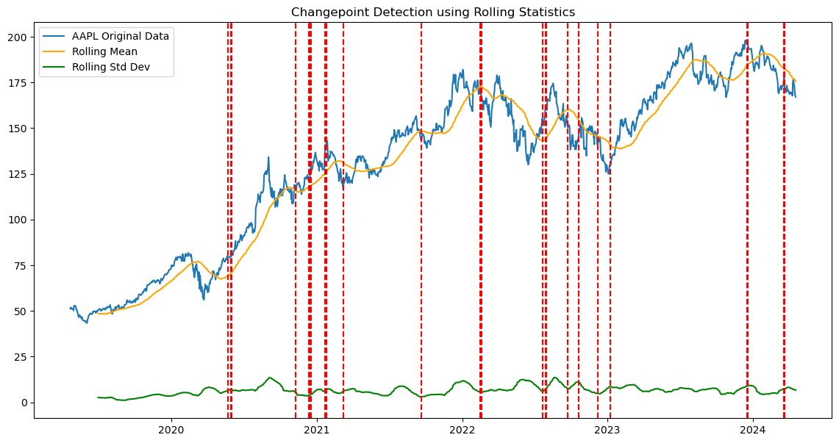
AAPL Stock Price

Slide 7
AAPL Stock Price
Yearly Financial Report
Seasonal Financial Report

Slide 8
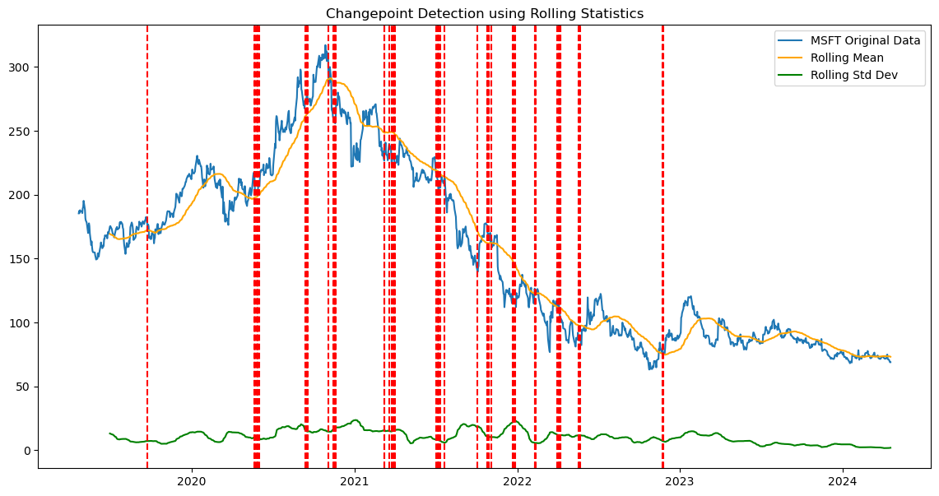
MSFT Stock Price
Yearly Financial Report
Seasonal Financial Report

Slide 9
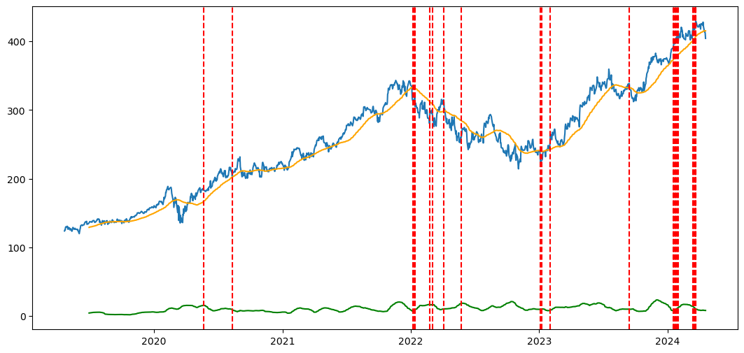
NVDA Stock Price
Yearly Financial Report
Seasonal Financial Report

Slide 10
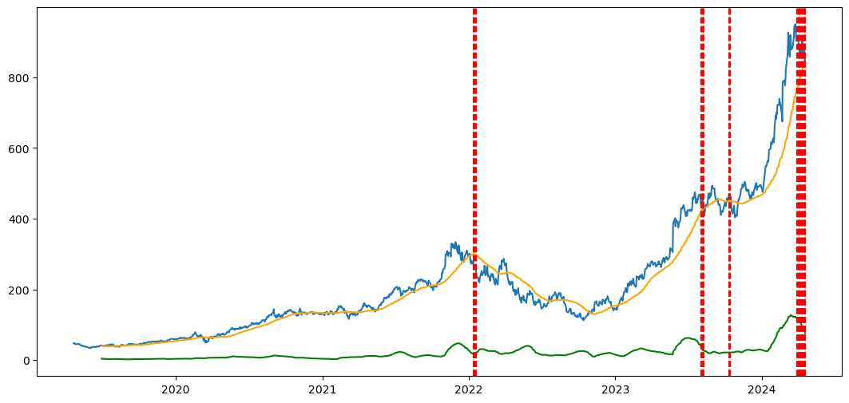
BABA Stock Price
Yearly Financial Report
Seasonal Financial Report

Slide 11
What Financial Factors?
Let’s see what correlation analysis says…

Slide 12
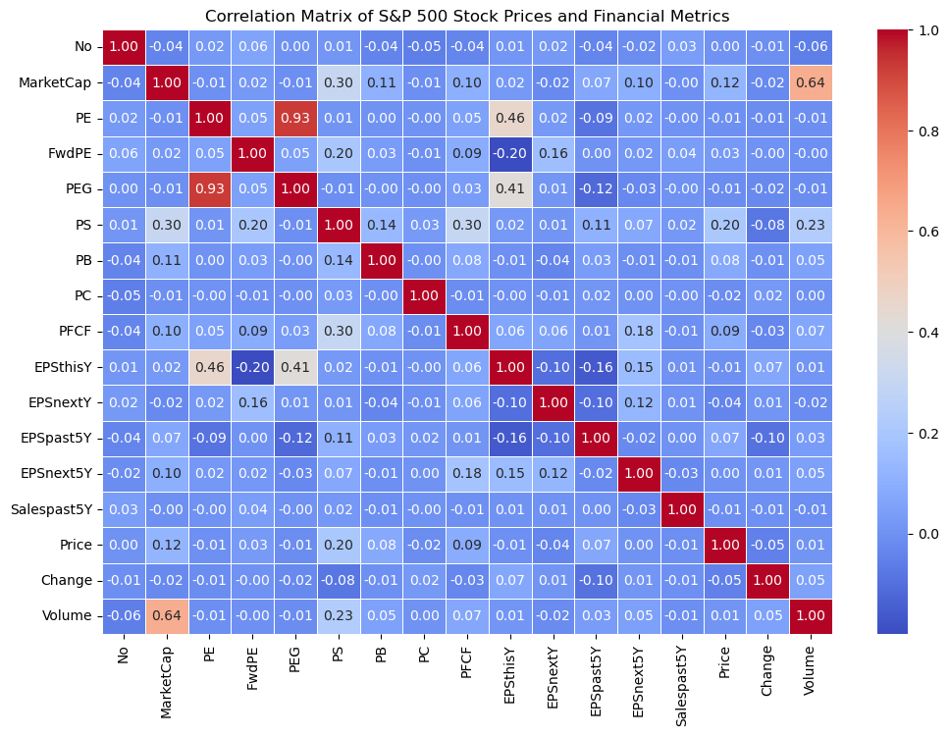
Heatmap of SP500
Too complicated?
Increase the thresholds

Slide 13
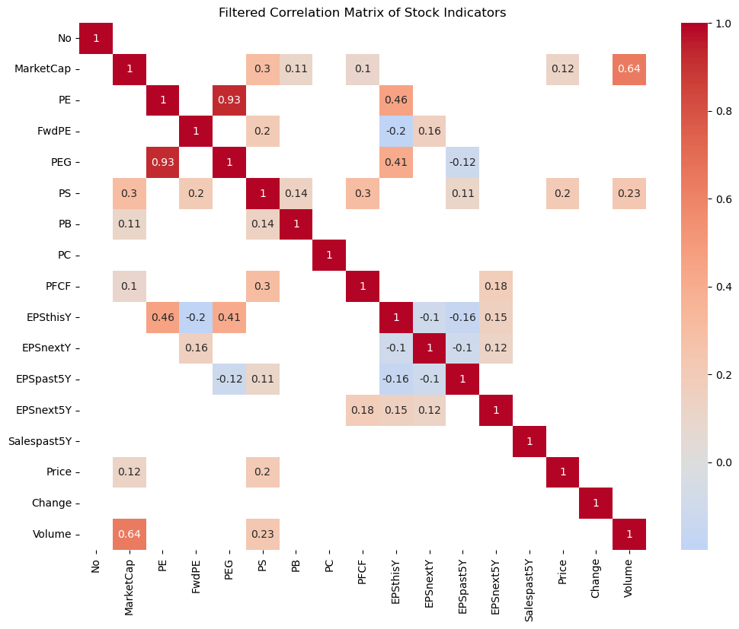
Heatmap of SP500
PE and PEG (0.93)
Volumn and MarketCap (0.64)
EPSthisY and PE (0.46)
EPSthisY and PEG (0.41)
PFCF and PS (0.3)
Price Related Factors:
PS Ratio (0.20) = Stock Price / Sales

Slide 14
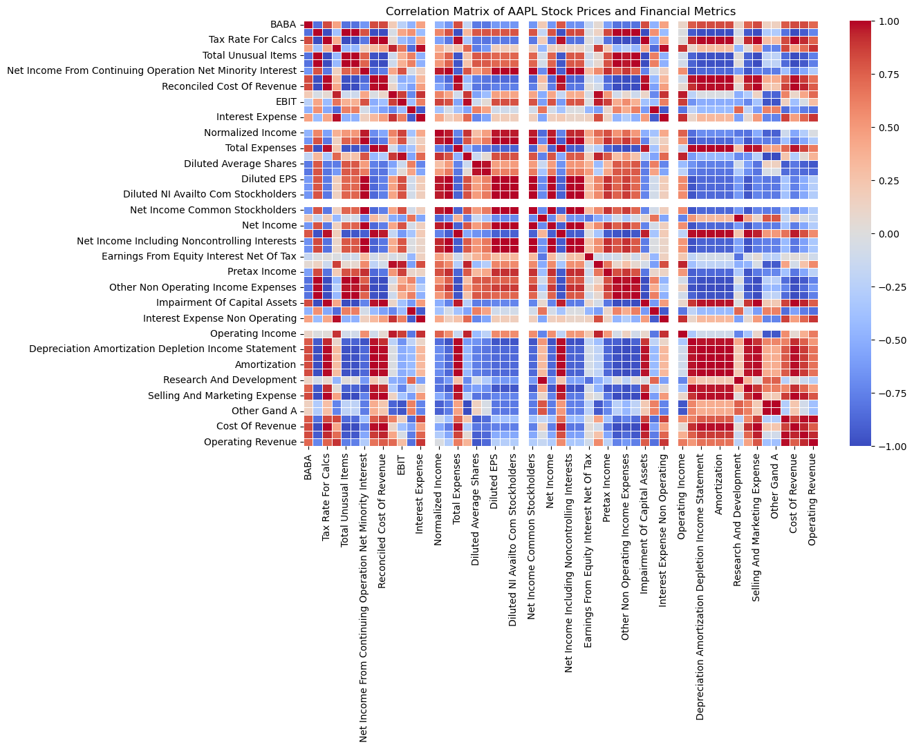
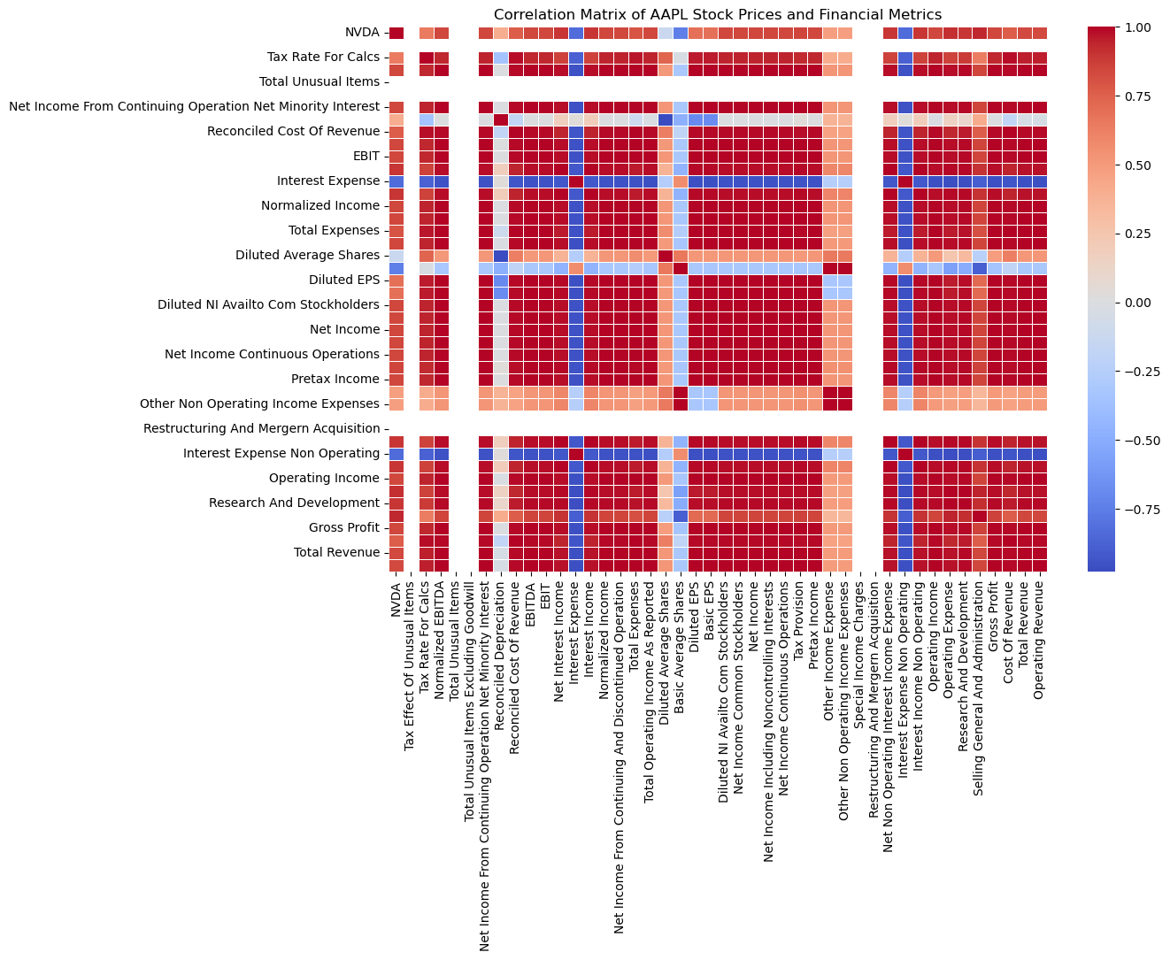
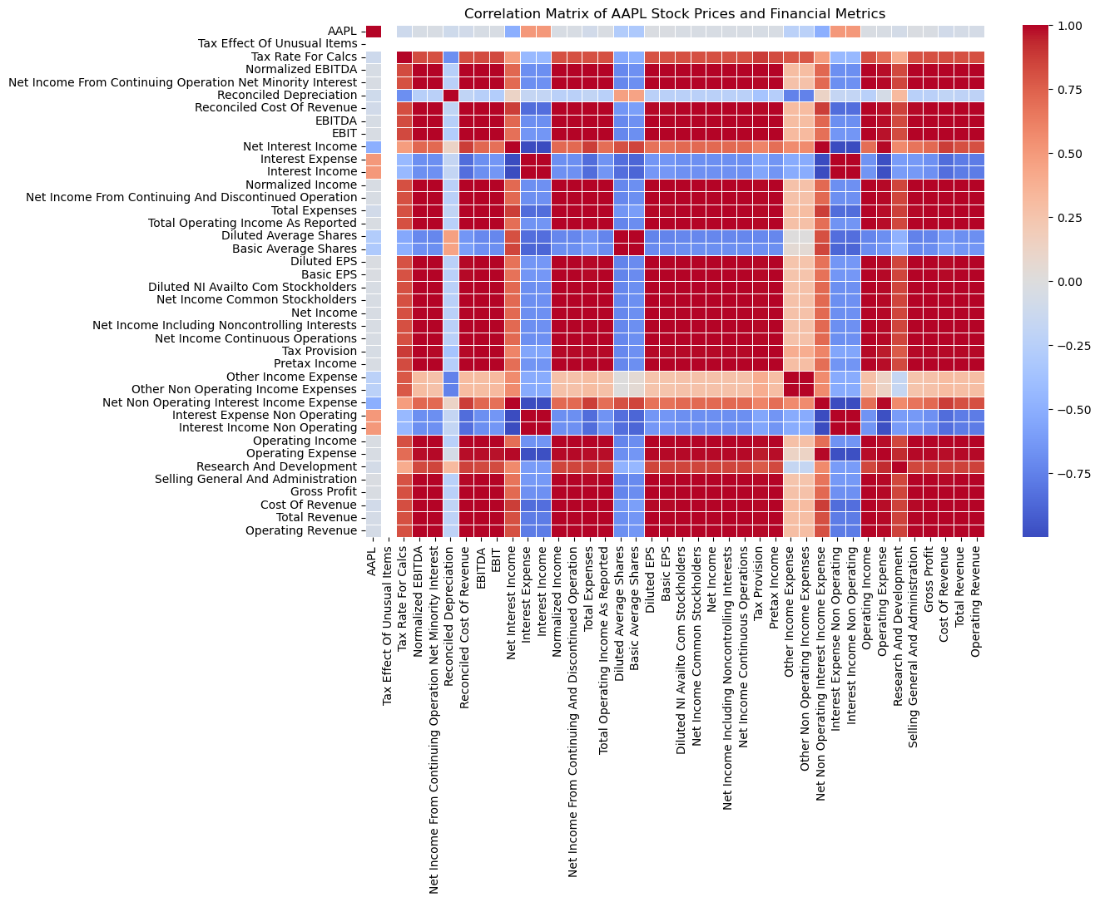
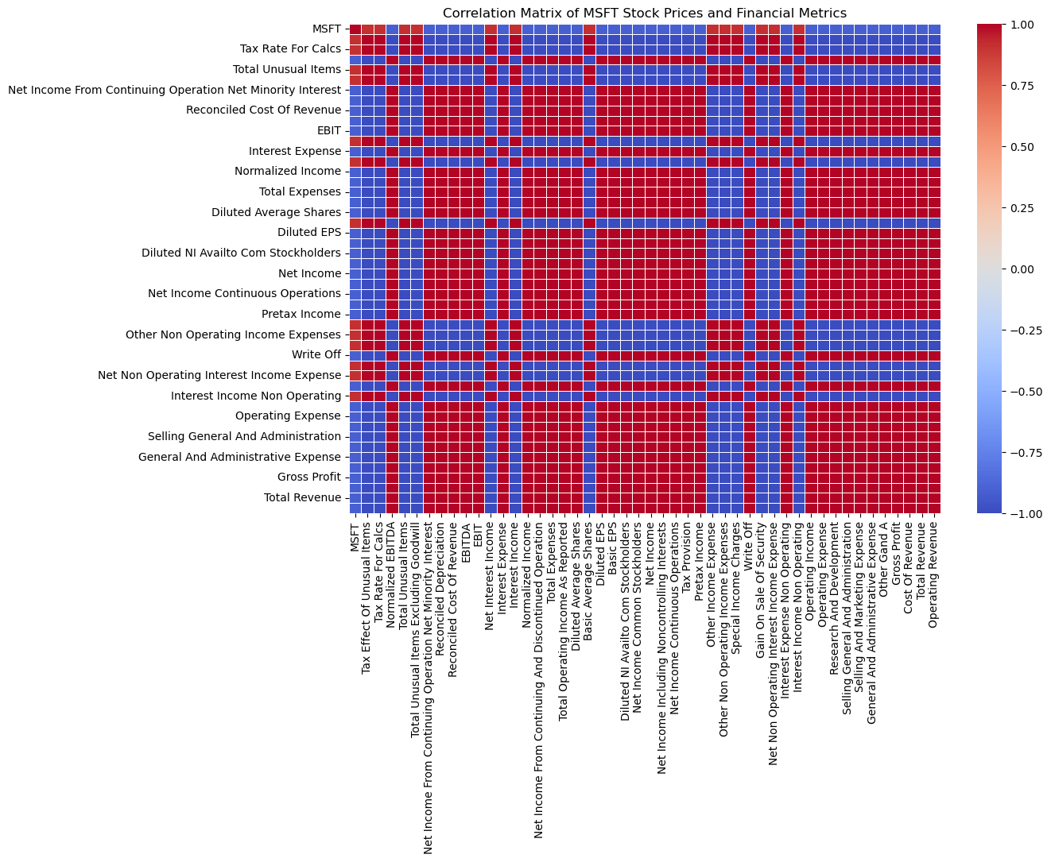

Slide 15
Financial Factors be Added to Model
'Interest Income Non Operating’
'Interest Income’
'Interest Expense Non Operating’
'Interest Expense’
'Basic EPS'
'Net Interest Income’
'Net Non Operating Interest Income Expense'
'Basic Average Shares’
'Diluted Average Shares’
'Net Income’
'Operating Income’

Slide 16
Long Short-Term Memory (LSTM) Model
Normalization: Using MinMaxScaler to scales the data to a fixed range of 0 to 1 (speed & performance)
Splitting Dataset: 80% Training, 20% Testing
Model Architecture: Sequential architecture consisting of bidirectional LSTM layers (past and future, accuracy)
Evaluation: Mean Squared Error (MSE), Root Mean Squared Error (RMSE), Mean Absolute Error (MAE), R-squared value, quantify the model's performance in terms of error magnitude and prediction accuracy
Now Let’s See the Result…

Slide 17
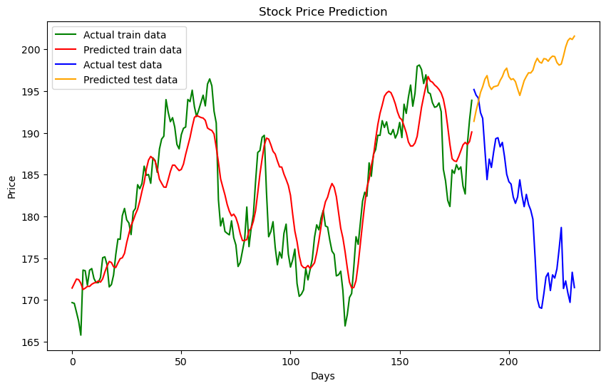
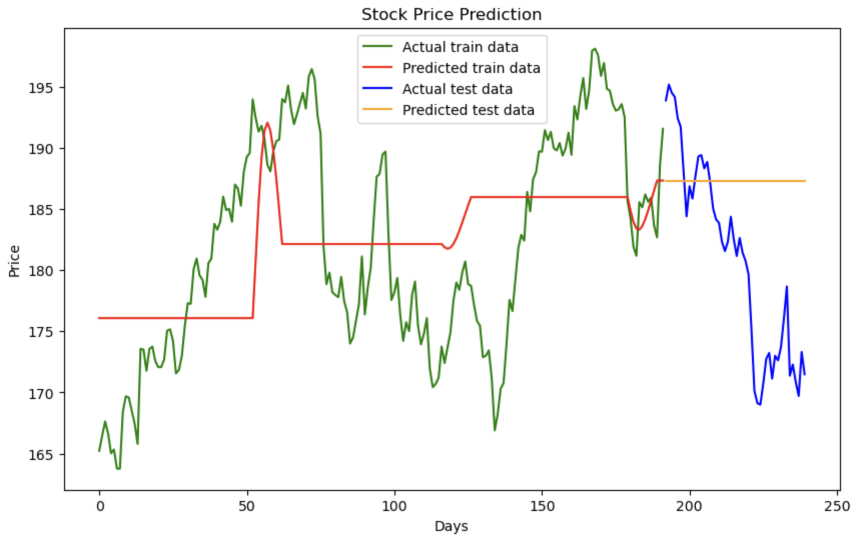
Mean Squared Error: 32399
Root Mean Squared Error: 179
Mean Absolute Error: 179.83
R-squared: -534.35
Prediction with S&P 500
Long Short-Term Memory (LSTM) Models
Prediction with Seasonal Financial Report Factors
Mean Squared Error: 32528
Root Mean Squared Error: 180
Mean Absolute Error: 180.182
R-squared: -516.61
Seasonal is A Problem!

Slide 18
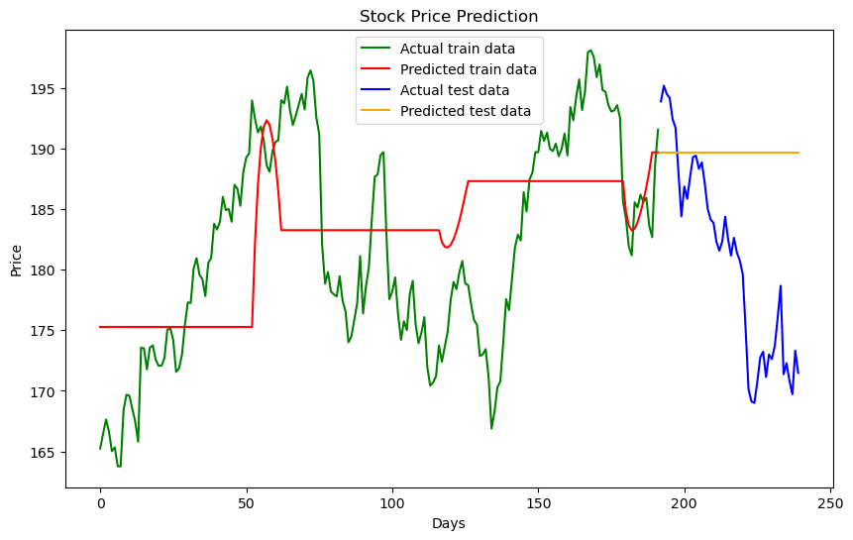
Mean Squared Error: 32399
Root Mean Squared Error: 179
Mean Absolute Error: 179.83
R-squared: -534.35
Prediction with S&P 500
Long Short-Term Memory (LSTM) Models
Prediction with Seasonal Financial Report Factors
Mean Squared Error: 32528
Root Mean Squared Error: 180
Mean Absolute Error: 180.182
R-squared: -516.61
Seasonal is A Problem!
Seasonal is A Problem!
Moving Averages Being Added Here

Slide 19
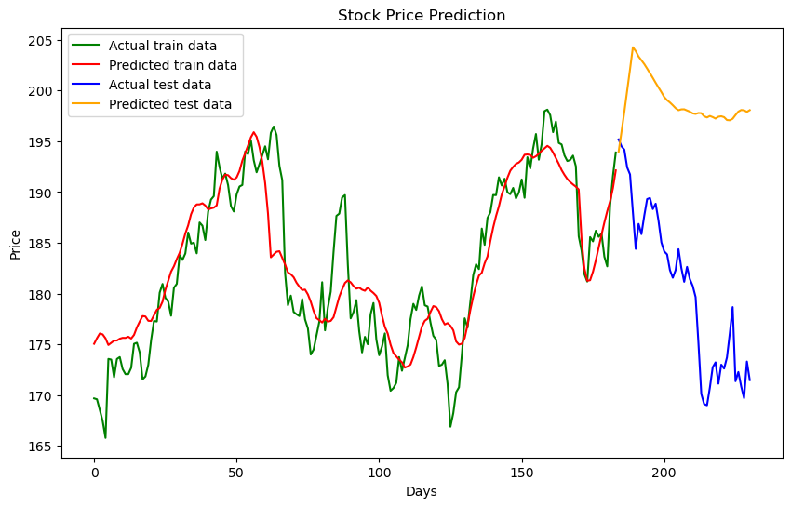
LSTM Time Series Model
LSTM Time Series Model enhanced by combining stock prices of AAPL, S&P 500, AAPL’s financial report datasets.
Significant
Improvement
Mean Squared Error: 1233
Root Mean Squared Error: 35
Mean Absolute Error: 33
R-squared: -20
Significant improvements in prediction accuracy
Capture broader market trends
Include reporting cycles that influence stock prices

Slide 20
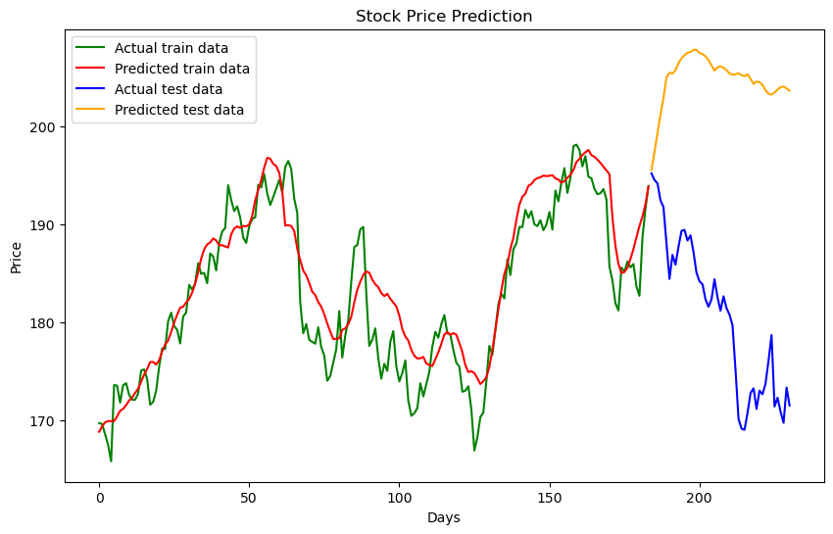
LSTM Time Series Model
LSTM Time Series Model enhanced by incorporating stock prices from MSFT, NVDA, BABA
Mean Squared Error: 479.72
Root Mean Squared Error: 21.90
Mean Absolute Error: 20.24
R-squared: -6.92
noticeable improvement in prediction accuracy
more market-related data provided
capture the complex dynamics of the stock market better

Slide 21
Further Improvements
Application
Risk Management: Estimate potential price volatility and risk
Timing for Buying/Selling: e.g. buying when a price increase is predicted and selling at predicted peaks.
Portfolio Diversification: Analyze correlations between different stocks or assets with the model to build a diversified investment portfolio.
Long-term Investment Strategies: Choose stocks with high long-term growth potential based on the model’s predictions of long-term trends.
More Data Dimensions: trading volume, macroeconomic indicators, industry news
Regularization: to prevent overfitting, incorporating L1 or L2 regularization.
Longer Period Dataset: analyzing longer historical data

Slide 22
Thank You So Much.
Any Questions?

